Slide 1

Practical New Developments in the BREACH Attack
Dimitris Karakostas
Dionysis Zindros
Notes:
Dionysis

Slide 2
Who are we?
Dimitris Karakostas & Dionysis Zindros
Researchers at Security & Crypto lab
University of Athens, Greece

Slide 3
HTTPS is broken
BREACH broke HTTPS + RC4 in 2013
People upgraded to AES – thought they were safe
Today...
We show TLS + AES is still broken
HTTPS can be decrypted
We launch open source tool to do it here in Singapore

Slide 4
Overview
BREACH review
Our contributions
Statistical attacks
Attacking block ciphers
Attacking noise
Optimization techniques
Our tool: Rupture
Mitigation recommendations

Slide 5



Original BREACH research
Introduced in Black Hat USA 2013
Angelo Prado
Neal Harris
Yoel Gluck
Notes:
BREACH was the sensation of BH 2013

Slide 6
BREACH attack anatomy

Slide 7
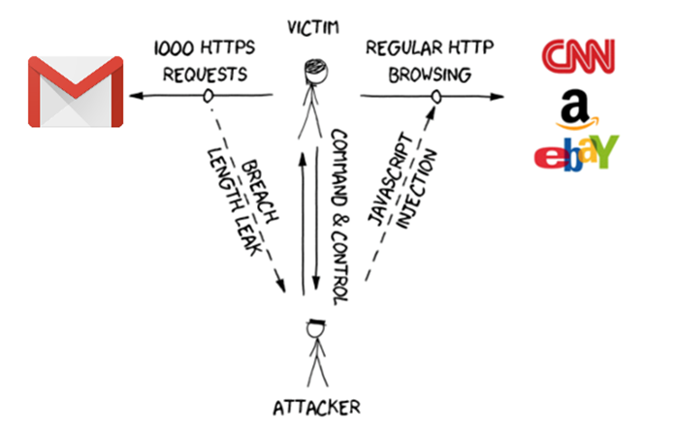

Slide 8
Original BREACH assumptions
Target website:
Uses HTTPS
Compresses response using gzip
Uses stream cipher
Response has zero noise
Contains end-point that reflects URL parameter
Notes:
Dimitris
We relax some assumption

Slide 9
Original BREACH target
Steal secret in HTTPS response (CSRF tokens)
Use CSRF to impersonate victim client to victim server

Slide 10

Length leaks
|E(A)| < |E(B)| ⇔ |A| < |B|
Notes:
Thai Duong in CRIME discovered web length leaks

Slide 11
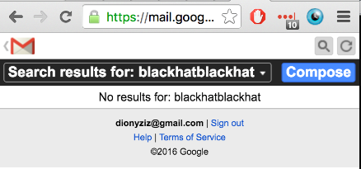
Let’s attack Gmail
m.gmail.com mobile Gmail view
Mobile search functionality uses HTTP POST – but HTTP GET still works :)
CSRF token included in response – valid for all of Gmail

Slide 12
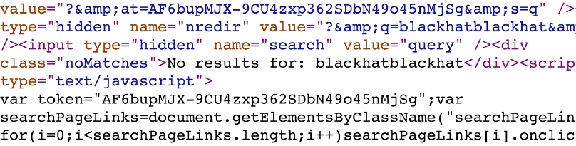
Noise
Reflection
Secret
Notes:
Noise is something that changes from response to response

Slide 13
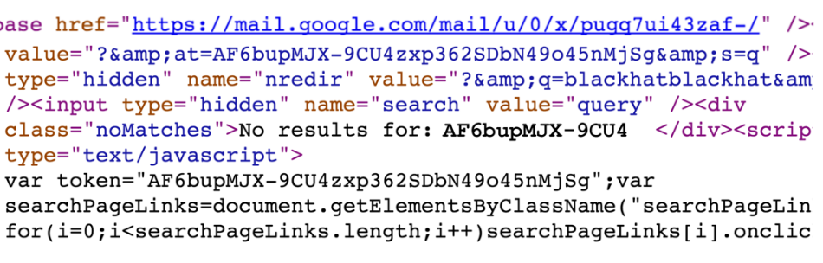
Attacker guesses part of secret
Uses it in reflection
Compressed/encrypted response is shorter if right!
Notes:
Bootstrap of the attack: AF6bup
Known secret: up to -9CU
Candidate: 4 (in this case it is the correct guess)
Correct guess = compressed well = short length of ciphertext

Slide 14
Original BREACH methodology
Guess part of secret and insert into reflection
Match? → Shorter length due to compression
No match? → Longer length
Bootstrap by guessing 3-byte sequence
Extend one character at a time
O(n|Σ|) complexity
n: length of secret
Σ: alphabet of secret
Notes:
Explain complexity and variables

Slide 15
Our contributions

Slide 16
Our contributions
We extend the BREACH attack
Alternative secrets
Attack noisy end-points
Attack block cipher end-points
Optimize attack
Novel mitigation techniques

Slide 17
Alternative secrets
Not only CSRF tokens can be stolen
Gmail email bodies
Facebook chat messages
Anything!
Masking CSRF tokens is not enough
Notes:
Facebook masks CSRF tokens but this is not enough

Slide 18
Statistical methods
Notes:
Our most important contribution

Slide 19
Statistical methods
We can attack noisy end-points
Multiple requests per alphabet symbol
Take mean response length
m-sized noise → attack works in O(n|Σ|√m)
m = (max response size) - (min response size)
Length converges to correct results (LLN)
Notes:
Dionysis

Slide 20
Statistical methods against block ciphers
Everyone uses block ciphers
Statistical methods break them
We introduce artificial noise
Block ciphers round length to 128-bits
In practice 16x more requests
Blocks aligned → Length difference measurable

Slide 21
Block alignment with artificial noise
For each candidate, send 16 requests
Pad each request with artificial noise
0…15 additional random bytes in reflection
This will cross a block boundary
Ideally, symbols that don’t appear elsewhere

Slide 22
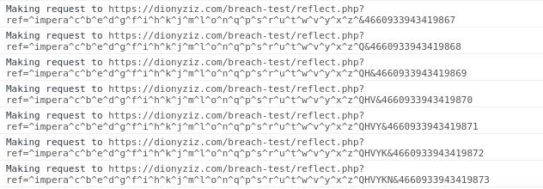
One sampleset in a batch: A single candidate (‘a’)
Reflected parameter
Reflected value
Known secret
Unreflected anti-caching
Target end-point
Candidate
Block alignment alphabet
Huffman pool

Slide 23
AES128 Block
secretXY (compressed: 15)
secreuXY (compressed: 16)
secrevXY (compressed: 16)
Additional observed block
secretXYZ (compressed: 16)
secreuXY (compressed: 16)
Z (compressed: 1)
secrevXY (compressed: 16)
Z (compressed: 1)
Notes:
Random permutation of candidate alphabet

Slide 24
Experimental results
AES_128 is vulnerable
Popular web services are vulnerable:
Gmail
Facebook
etc.
Notes:
Dimitris

Slide 25
Noise generators
Noise = Response part that changes per request
Web app noise: Timestamps, random token
Connection: close / keep-alive
Huffman header encoding
Huffman tree changes due to block alignment padding :(
We can’t predict how it changes – plaintext unknown
Content-encoding: chunked – boundaries may change
Notes:
Alerts

Slide 26
Optimizations

Slide 27
Optimizations overview
Block ciphers cause min 16x slowdown. We need to optimize.
Divide and conquer: 6x speed-up
Request soup: 16x speed-up
Browser parallelization: 6x speed-up
Total ~ 500x speed-up!
Notes:
+ noise slowdown sqrt(n)

Slide 28
Optimization: Divide & Conquer
Each request tries multiple candidates from alphabet
Partition alphabet using divide-and-conquer
Binary search on alphabet partitions
Reduces attack complexity from O(n|Σ|) to O(n lg|Σ|)
Practically this gives 6x speed-up

Slide 30
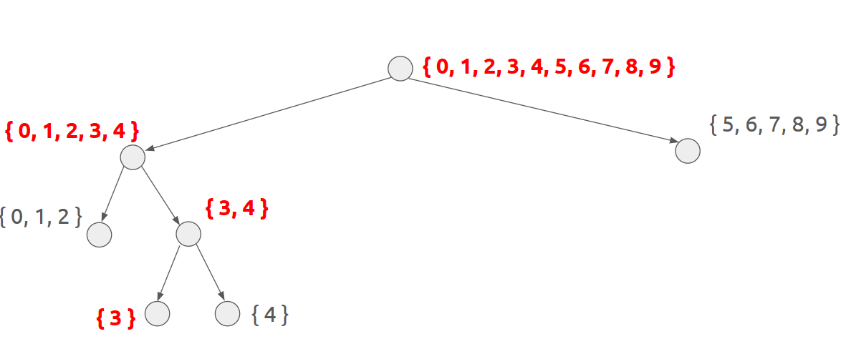
Binary search in alphabet space

Slide 31
Optimization: Request soup
Problem:
Need 16x samples for block ciphers
But we only need the length mean
Solution:
Responses come pipelined, can’t tell them apart
We don’t care! Measure total length
Divide by amount, extract mean
Notes:
Dionysis

Slide 32
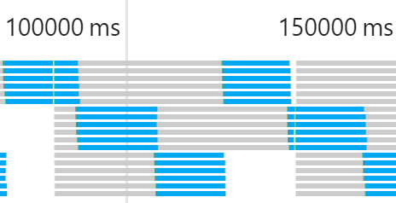
Optimization: Browser parallelization
Do 6x parallel requests; browsers support it
Each parallel request cannot adapt based on previous
But we need many samples of same candidates anyway
No need to adapt before we collect enough

Slide 33
Request soup + browser parallelization:
16 requests in 1.5 sec
(in good network)

Slide 34
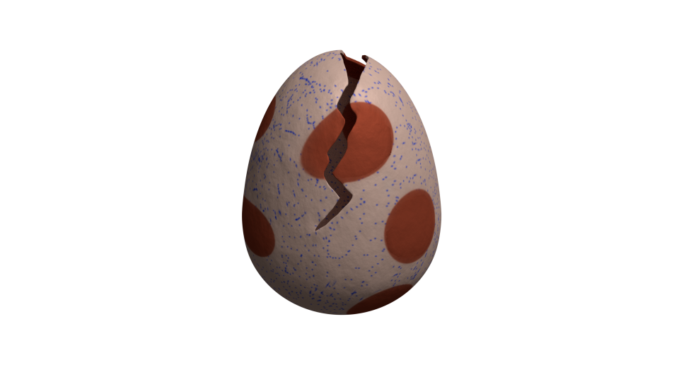
Rupture

Slide 35
Today, we make BREACH easy
Over the past months, we’ve developed Rupture
Today in Black Hat Asia 2016, we launch it
Open source: MIT licensed
https://github.com/dionyziz/rupture
ruptureit.com

Slide 36
Rupture
Extensible
Modular analysis / optimizations / strategies
Experiment with your own
General web attack framework
Can be adapted to work for CRIME, POODLE, …
Persistent command & control channel
Scalable architecture: Multiple attacks simultaneously

Slide 37
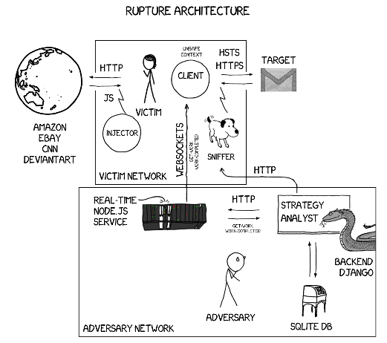

Slide 38
Robust, persistent command & control
Automatically inject JS to HTTP
All plaintext connections infected
One tab at a time gets work from C&C server
User closes tab? Different tab starts attacking
User switches browsers? Works on different browser
Data collection failed for a sample? Sample recollected
User reboots computer? Attack continues

Slide 39
Persistent attack data storage
Collected data processed by Django middleware
Attack historical data stored permanently in SQLite db
Future analysis with new techniques possible

Slide 40
Rupture demo

Slide 41
Statistically expected* runtime
Assuming limited noise:
Using sequential technique: 3 min / byte
3 batches per candidate
Using divide & conquer: 36 sec / byte
* Additional batches may be needed if confidence is low

Slide 42
Mitigation

Slide 43
First-party cookies
Don’t send auth cookies cross-origin
Backwards compatibility: Web server opts-in
Mike West implemented it in Chrome 51
Coming April 8th
Set-Cookie: SID=31d4d96e407aad42; First-Party

Slide 44
Future work
Responsible disclosure:
Publish specific preconfigured Rupture “targets” – Gmail, Facebook, etc.
In coordination with web app developers
Implement First-Party cookies in Firefox and other browsers
Extend Rupture with other attacks: CRIME, etc.
Implement SPDY support for Rupture
Backtracking
Come help us make Rupture better – many bugs on GitHub

Slide 45
Key takeaways
HTTPS + gzip = broken
Rupture framework is live – attacks are easy
Enable first-party cookies on your web app

Slide 46
Thank you! Questions?
twitter.com/dionyziz
45DC 00AE FDDF 5D5C B988 EC86 2DA4 50F3 AFB0 46C7
github.com/dimkarakostas
DF46 7AFF 3398 BB31 CEA7 1E77 F896 1969 A339 D2E9

Slide 47
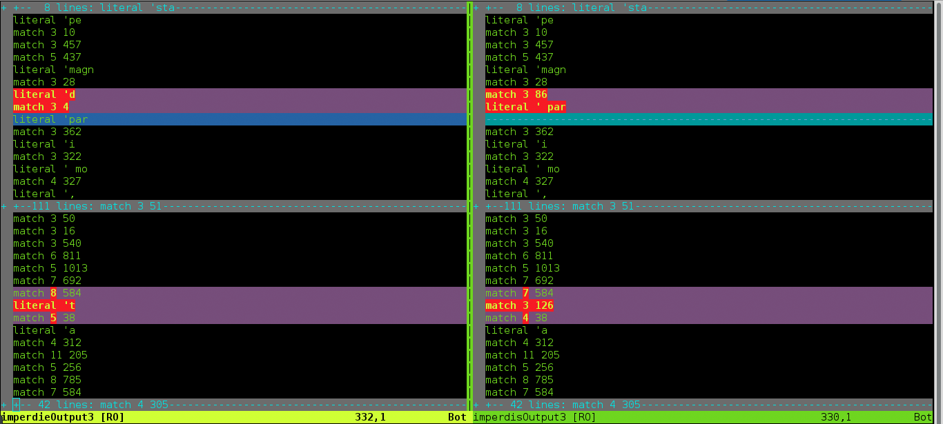
Notes:
Compression with other part of the text – can be solved with backtracking

